Slide 1
Statewide Analysis of Bicycle Crashes in North Carolina
Prepared by:
Matt Dardari
Preethika Gajendran
Rashi Waghray

Slide 2

Project Objectives
Study overall statewide bicycle crash patterns and trends in North Carolina.
Perform descriptive trend analysis based on the following factors:
Environmental
Bicyclist-related
Crash location
Motorist / Motor Vehicle-related
Roadway Characteristics
Identify and analyze bicycle hot spots for crash causes and counter measures
Identify and analyze danger zones based on crashes that resulted in fatalities

Slide 3
Dataset
https://www.chapelhillopendata.org/
Maps the locations of crashes involving bicyclists in North Carolina from Jan 2007-Dec 2018
Police-reported collisions between:
bicycle-motor vehicle
pedestrian-motor vehicle
Crashes occurred on:
the public roadway network
public vehicular areas
private properties (if reported)
Total crashes analyzed = 11266
All 100 counties within the State
327 cities
Crash sites not within the bounds of these 327 cities are categorized as “Rural” sites
Exclusions:
Crash identification numbers
Fatality information

Slide 4
Trend Analysis – Environment Factors
43% of the crashes occur in the Summer (Jun-Sep)

Slide 5
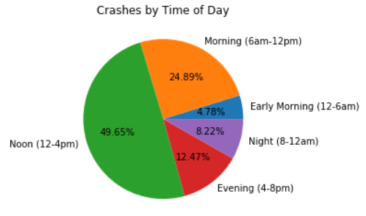
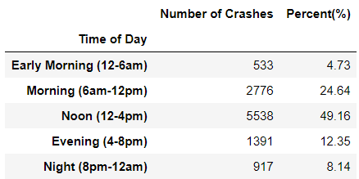
Trend Analysis – Environment Factors
43% of the crashes occurred in the Summer (Jun-Sep)
Nighttime bicycle crashes resulted in more fatalities compared to daytime crashes

Slide 6
Trend Analysis – Bicyclist-related (1 of 4)
Crashes involving elder bicyclists (> years) resulted in more fatalities compared to younger bicyclists (<65 years)
Crashes involving male bicyclists resulted in more fatalities compared to crashes involving female bicyclists

Slide 7
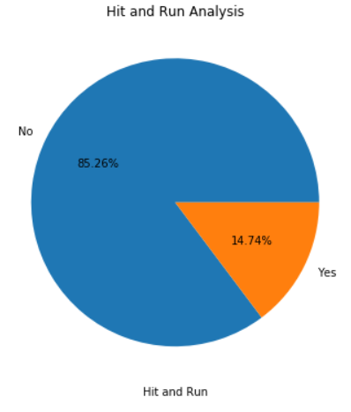
Trend Analysis – Bicyclist-related (2 of 4)
Of the ~15% Hit-n-Run cases:
29 (1.7%) resulted in bicyclist fatalities and
2 (0.12%) motor-vehicle driver fatalities

Slide 8
Trend Analysis – Bicyclist-related (3 of 4)

Slide 9
Trend Analysis – Bicyclist-related (4 of 4)

Slide 10
Trend Analysis – Crash Location related factors
Majority crashes occurred on urban roadways; only 15% were on rural areas (<30% developed)

Slide 11
Key Findings
Only 7% of all bicyclists involved in crashes were intoxicated of which
f alcohol were killed, and a high 27.6% of all bicyclists involved in crashes who were under the influence of drugs were killed
Crashes involving bicyclists cycling along the roadway against traffic were found to be more severe compared to those involving bicyclists cycling along the roadway with traffic.
In terms of bicyclist’s action at the time of the crash, motorist overtaking was the most frequent contributing cause, resulting in about 10% of total crashes.
Among all types of vehicles, passenger cars were found to result in relatively less severe crashes.
Nightime crashes ??

Slide 12


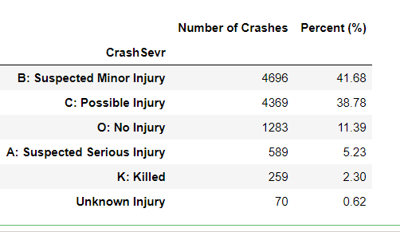
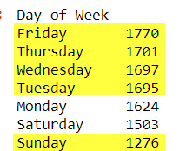
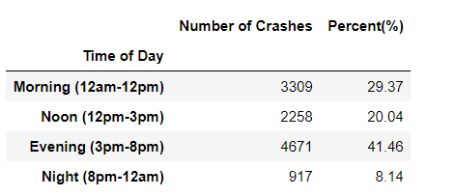
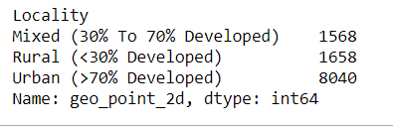
Total crashes: 11266
Number of Counties : 100
Number of Cities: 327
Only 7% involved intoxicated Bikers
14.74% were Hit-n-Run cases
Least crashes on Sundays (due to low traffic?)
Other days are almost equal
Nighttime bicycle crashes resulted in more fatalities compared to daytime crashes.
71% were in urban areas

Slide 13
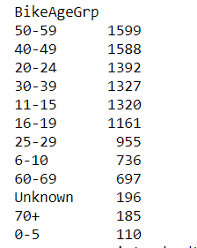
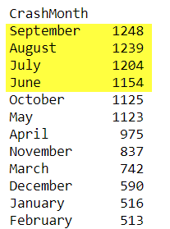
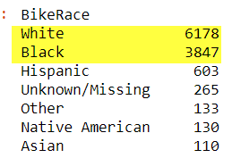
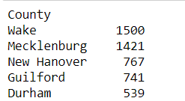
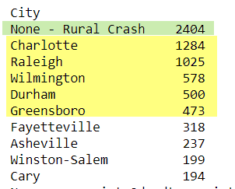

Most crashes happen in Summer Months (Jun-Sep)
More than half are white bikers (54.83%)
Age grouping
Top 5 Counties with most crashes
About 1/5th crashes are from rural areas
Top 5 cities with most crashes are:
Gender grouping

Slide 14
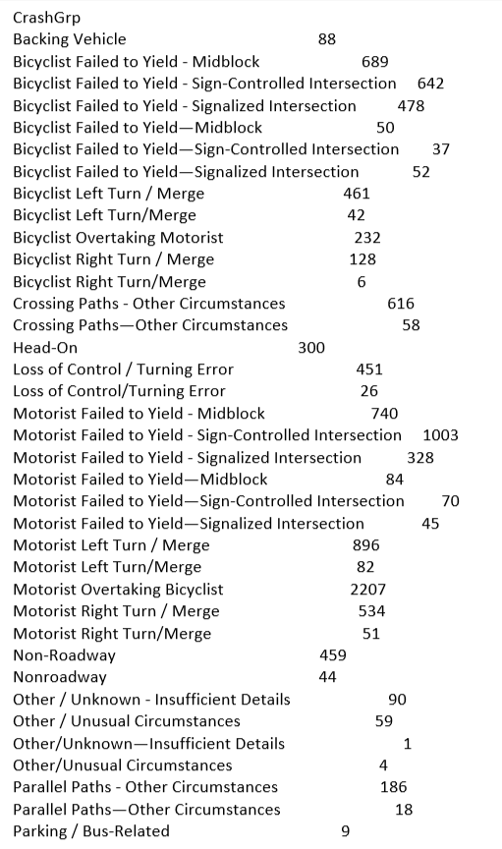

Slide 15
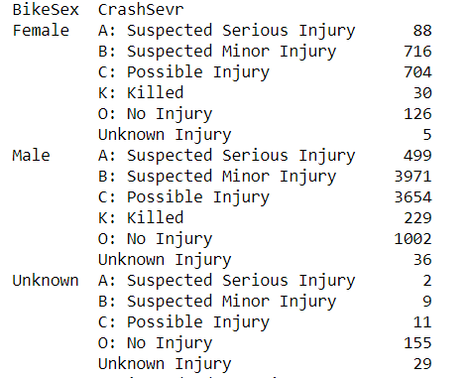
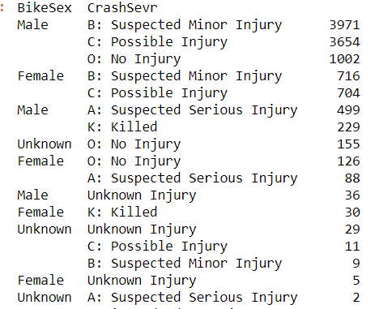
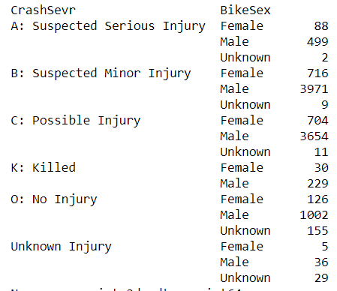
Crash Severity Vs. Gender – multiple views
Sorted
Sorted

Slide 16
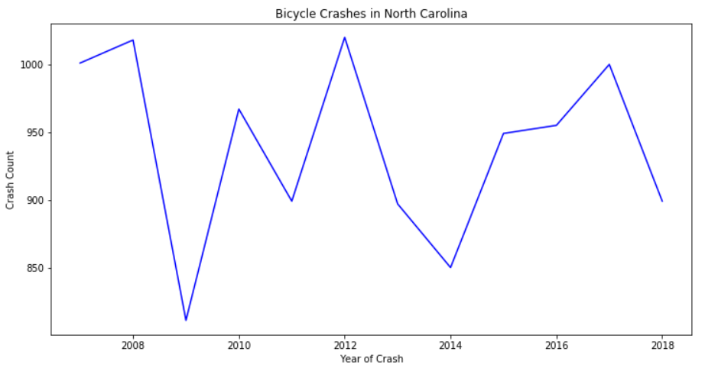
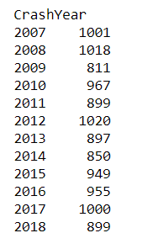
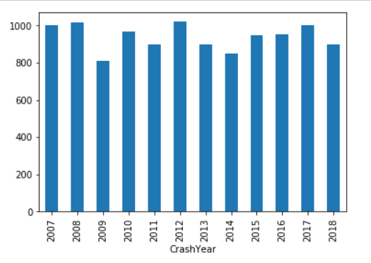
Total crashes: 11266
Number of Counties : 100
Number of Cities: 327
There is no drastic change in crash counts from 2007

Slide 17
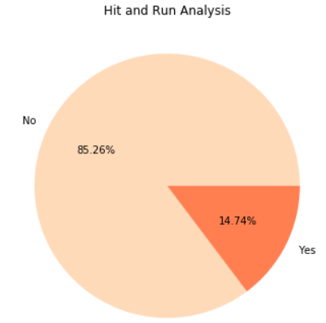

Slide 18
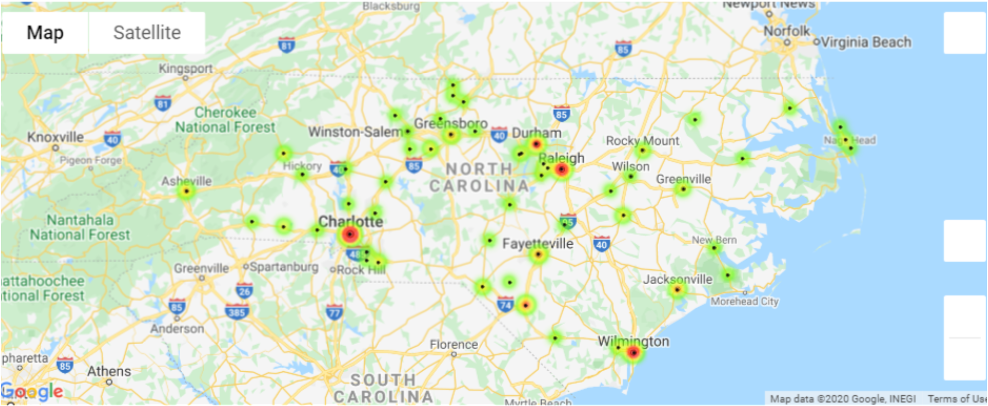
Fatal Cities – Crashes that resulted in fatalities

